Slide 1

Long Term Potentiation (LTP) and Long Term Depression (LTD): An Overview of Two Novel NMDA Receptor Regulatory Proteins
Nick Murray and Dr. Jan Wotton
May 2010

Slide 2
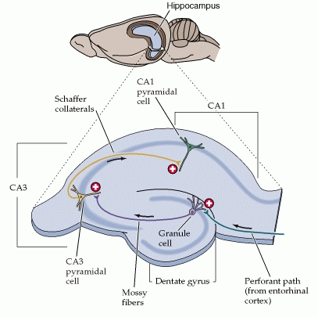
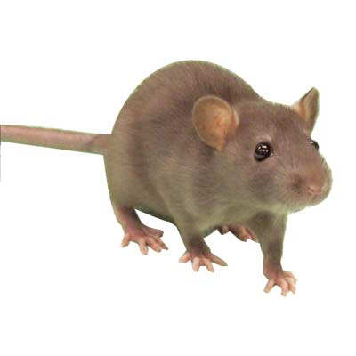
Long Term Potentiation/Depression

Slide 3
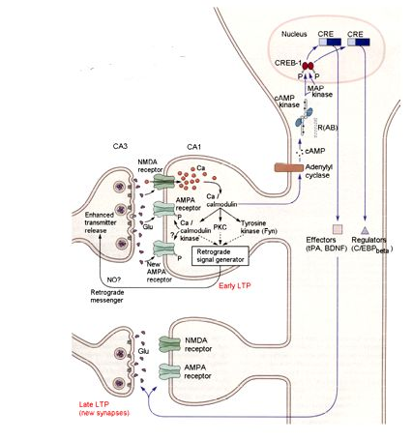
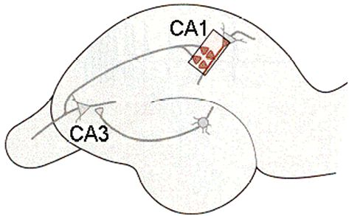
Long Term Potentiation/Depression

Slide 4
←Little Red Box

Slide 5
Rodent Hippocampus →

Slide 6
NMDA (N-methyl D-aspartate) Receptor
Gustavus Neuroscience
Notes:
The NMDA receptor forms a heterotetramer between two NR1 and two NR2 subunits, which explains why NMDA receptors contain two obligatory NR1 subunits and two regionally localized NR2 subunits. A related gene family of NR3 A and B subunits have an inhibitory effect on receptor activity. Multiple receptor isoforms with distinct brain distributions and functional properties arise by selective splicing of the NR1 transcripts and differential expression of the NR2 subunits.
Each receptor subunit has modular design and each structural module also represents a functional unit:
The extracellular domain contains two globular structures: a modulatory domain and a ligand-binding domain. NR1 subunits bind the co-agonist glycine and NR2 subunits bind the neurotransmitter glutamate.
The agonist-binding module links to a membrane domain, which consists of three trans-membrane segments and a re-entrant loop reminiscent of the selectivity filter of potassium channels.
The membrane domain contributes residues to the channel pore and is responsible for the receptor's high-unitary conductance, high-calcium permeability, and voltage-dependent magnesium block.
Each subunit has an extensive cytoplasmic domain, which contain residues that can be directly modified by a series of protein kinases and protein phosphatases, as well as residues that interact with a large number of structural, adaptor, and scaffolding proteins.

Slide 7
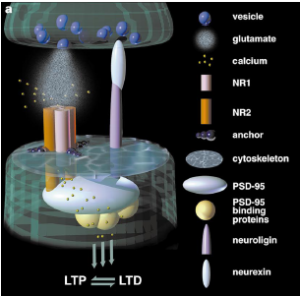
NMDA Receptor as a Coincidence Detector
Gustavus Neuroscience
Post synaptic density protein-95 (PSD-95)
→ Regulator of bidirectional synaptic plasticity

Slide 8
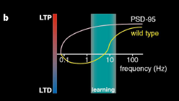
LTP Specific Hippocampal Frequencies
Gustavus Neuroscience

Slide 9
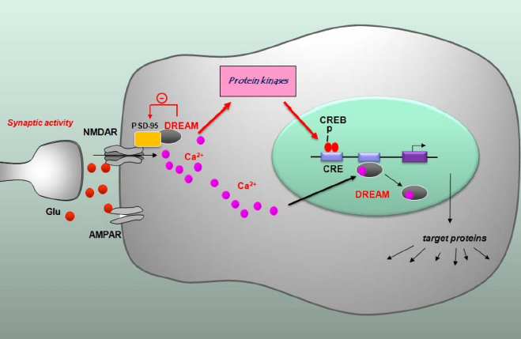
Regulation of NMDA Receptor Gating
Gustavus Neuroscience

Slide 10
Acknowledgements
&
Literature Consulted
- Dr. Jan Wotton and Dr. Mike Ferragamo
Johns Hopkins University Department of Neuroscience
An, W., M. Bowlby, M. Betty, J. Cao, H. Ling, G. Mendoza, K. Mattsson, B. Strassle, J. Trimmer, and K. Rhodes. 2000. Modulation of A-type potassium channels by a family of calcium sensors. Nature 403: 553-556.
Bliss, T., and Terje Lømo. 1973. Long-lasting Potentiation of Synaptic Transmission in the Dentate Area of the Anaesthetized Rabbit Following Stimulation of the Perforant Path. Journal of Physiology 232: 331-356.
Buxbaum, Joseph. 2004. A role for calsenilin and related proteins in multiple aspects of neuronal function. Biochemical and Biophysics Research Communications 322:1140-1144.
Buxbaum, Joseph, Eun-Kyoung Choi, Yuxia Luo, Christinal Lilliehook, Annette Crowley, David Merriam, and Wilma Wasco. 1998. Calsenilin: a calcium-binding protein that interacts with the presenilins and regulates the levels of a presenilin fragment. Nature Medicine 4(10): 1177-1181
Carrión, Angel, Wolfgang Link, Fran Ledo, Britt Mellstrom, and Jose Naranjo. 1999. DREAM is a Ca ²⁺- regulated transcriptional repressor. Nature 398: 80-84.
Cheng, Hai-Ying, Graham Pitcher, Steven Laviolette, Ian Whishaw, Kit Tong, Lisa Kockeritz, Teiji Wada, Nicholas Joza, Michael Crackower, Jason Goncalves, Ildiko Sarosi, James Woodgett, Antonio Oliveira-dos-Santos, Mitsuhiko Ikura, Derk Kooy, Michael Salter, and Josef Penninaer. 2002. DREAM is a critical transcriptional repressor for pain modulation. Cell 108: 31-43.
Fontan-Lozano, Angela, Rocio Romero-Granados, Yaiza del-Pozo-Martin, Irene Suarez-Pereira, Jose Delgado-Garcia, Josef Penninger, and Angel Carrión. 2009. Lack of DREAM protein enhances learning and memory and lows brain aging. Current Biology 19: 54-60.
Hebb, Donald. 1949. The Organization of Behavior: A Neuropsychological Theory. New York: John Wiley & Sons.
Kim, E. and M. Sheng. 2004. PDZ domain proteins of synapses. Nature Reviews Neuroscience 5: 771-781.
Kauer, Julie and Robert Malenka. 2007. Synaptic plasticity and addiction. Nature Neuroscience Review 8: 844-858.
Kornau, H., T. Schenker, M. Kennedy, and P. Seeburg. 1995. Science. Domain interaction between NMDA receptor subunits and the postsynaptic density protein PSD-95. Science 269 (5231): 1737-1740.
Kuby, Janis, Thomas Kindt, Richard Goldsby, and Barbara Osbourne. 2007. Immunology 6 ed. New York: W.H. Freeman.
Ledo, Fran, Leonor Kremer, Britt Mellstrom, and Jose R.Naranjo. 2002. Ca²⁺-dependent block of CREB-CBP transcription by repressor DREAM. The EMBO Journal 21(17): 4583-4592.
Li, Fei and Joe Tsien. 2009. Memory and the NMDA receptors. New England Journal of Medicine 361 (3): 302-303.
Lusin, Jacqueline, Murugendra Vanarotti, Congmin Li, Aswani Valiveti, and James Ames. 2008. NMR structure of DREAM: Implications for Ca²⁺ - dependent DNA binding and protein dimerization. Biochemistry 47: 2252-2264.
MacDonald, John, Michael Jackson, and Michael Beazely. 2006. Hippocampal long-term synaptic plasticity and signal amplification of NMDA receptors. Critical Reviews in Neurobiology 18(1-2): 71-84.
Mandel, Gail and Goodman, Richard. 1999. DREAM on without Calcium. Nature 398: 29-30.
Miguad, Martine, Paul Charlesworth, Maureen Dempster, Lorna Webster, Ayako Watabe, Michael Makhinson, Yong He, Mark Ramsay, Richard Morris, John Morrison, Thomas O’Dell, and Seth Grant. 1998. Enhanced long-term potentiation and impaired learning in mice with mutant postsynaptic density-95 protein. Nature 396:433-439.
Nakanishi, S., M. Masu, Y. Bessho, Y. Nakajima, Y. Hayashi, and R. Shigemoto. 1994. Molecular diversity of glutamate receptors and their physiological functions. EXS 71: 71 -80.
Ng, David, Graham Pitcher, Rachel Szilard, Andrea Sertie, Marijana Kanisek, Steven Clapote, Tatiana Lipina, Lorraine Kalia, Daisy Joo, Colin McKerlie, Miguel Cortez, John Order, Michael Salter, and Roderick McInnes. 2009. Neto1 is a novel CUB-domain NMDA receptor-interacting protein required for synaptic plasticity and learning.
Osawa, Masanori, Kit Tong, Christina Lilliehook, Wilma Wasco, Joseph Buzbaum, Mary Cheng, Josef Penninger, Mitsuhiko Ikura, and James Ames. 2001. Calcium-regulated DNA binding and oligomerization of the neuronal calcium-sensing protein, Calsenilin/DREAM/KChIP3. Journal of Biological Chemistry 267:41005-41013.
Purves, Dale, George Augustine, David Fitzpatrick, William Hall, Anthony-Samuel LaMantia, James McNamara, Leonard White. 2008. Neuroscience. Sunderland (MA): Sinauer Associates.
Rivas, Marcos, Britt Mellstrom, Begona Torres, Gaetano Cali, Alfonso Ferrara, Daniela Terracciano, Mariastella Zannini, Gabriella Escobar, and Jose Naranjo. 2009. The DREAM protein is associated with thyroid enlargement and nodular development. Molecular Endocrinology 23: 862-870.
Roberson, Erik, Joey English, and J. David Sweatt. 1996. A biochemist’s view of LTP. Learning and Memory 3:1-24.
Sweatt, David. 1999. Toward a Molecular Explanation for Long-Term Potentiation. Learning and Memory 6:399-416.
Tang, Ya-Ping, Eiji Shimizu, Gilles Dube, Claire Rampon, Geoffrey Kerchner, Min Zhuo, Guosong Liu, and Joe Tsien. 1999. Genetic enhancement of learning and memory in mice. Nature 401: 63-69.
Vallejo, Mario. 2009. PACAP signaling to DREAM: a cAMP-dependent pathway that regulates cortical astrogliogenesis. Molecular Neurobiology 39: 90-100.
Winder, D., I. Mansuy, M. Osman, T. Moallem, E. Kandel. 1998. Genetic and Pharmacological evidence for a novel, intermediate phase of long-term potentiation suppressed by calcineurin. Cell 92: 25-37.
Woo, Ha-Na, Chang Jae-Woong, Choi Yun-Hyung, Gwon A-Ryeong, Jung Yong-Keun, and Jo Dong-Gyu. 2008. Characterization of subcellular localization of Ca ²⁺ modulation of calsenilin/DREAM/KChiP3. Molecular Neuroscience 19 (12): 1193-1197.
Wu, Long-Jun, Britt Mellstrom, Hansen Wang, Ming Ren, Sofia Domingo, Susan Kim, Xiang-Yao Li, Tao Chen, Jose Naranjo, and Min Zhuo. DREAM (downstream regulatory element antagonist modulator) contributes to synaptic depression and contextual fear memory. Molecular Brain 3: 1-13.
Xiong, Hui, Kun Xia, Benshang Li, Guoping Zhao, and Zhuohua Zhang. 2009. KChIP1: a potential modulator of to GABAergic system. Acta Biochimica et Biophysica Sinica 41(4): 295-300.
Gustavus Neuroscience

Slide 11

nmurray@gustavus.edu
Nick is pursing a M.D.at the University of Iowa Carver College of Medicine, Class of 2014

